Slide 1


Commissioning Carers’ Support: emerging findings from the Carer Practice Study
Jill Manthorpe, Jo Moriarty,
Michelle Cornes and Shereen Hussein

Slide 2
Our study: a concurrent mixed method design
Interviews
Family carers
Survey
National survey of councils with social services responsibilities
Documents
Care plans
Leaflets and brochures
Analysis of Carers Workers in NMDS-SC (Hussein & Manthorpe, 2012)
National workforce data
Carers' workers
Voluntary organisations
Commissioners

Slide 3

What or whom is being commissioned?
Can we distinguish staff supporting family carers from other social care staff?
Of 24,301 employers who completed the NMDS-SC (June 2010) only 0.4% (n=97) indicated that their main service was to support family carers (eg working in a Carers’ Centre)
BUT when considering those who provided services for carers as their main or additional service, this proportion increased to 8.5% (n=2,064) of employers
In the main their employees are female, part-time, home care workers – with the characteristics of being in high turnover agencies, unqualified, ‘flexible’ and working on their own.
Hussein and Manthorpe (2012) The diversity of staff supporting family carers in England: findings from an analysis of a national data set, Equality in health and social care

Slide 4
Focusing on named carers’ workers and what they do…
Four case study sites in England
Interviews with over 80 participants | ☺
Surveys completed by over 50 per cent of local councils | ☺
Difficulties with accessing and synthesising care plans – ended up probing content and rationale of carers’ assessments and care plans with social workers in two teams (lessons here for separate carers’ assessment) | 😐

Slide 5
Talking to commissioners
Re-organisation without
(CCGs, Federation, Locality)
Re-organisation within
Demand pressures
Decommissioning
Personalisation
Prevention

Slide 6
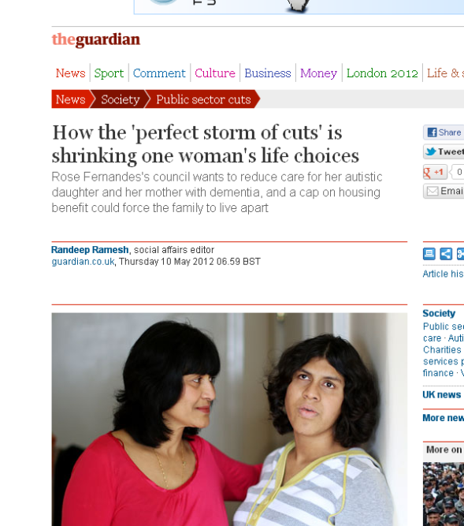
Managing the money
Financial pressures (cuts) have heightened the contrast between providing preventative support to carers under DH 2010 guidance and local eligibility criteria
The Guardian 10 May 2012

Slide 7
The commissioner’s dilemmas: eligibility criteria (1)
The difficulty with FACS, as anybody who understands a business will tell you, is that we probably have a certain amount of people in the community who are vulnerable. Any social worker doing an assessment on a vulnerable person who thinks they need a service will describe them as critical. ..So what we've done is created this intellectual vaulting, which you would then need another system set in place to challenge the vaulting. So you would then need your managers to be more street savvy than the social workers. What a waste of public resource. (COMMISSIONER4)

Slide 8
Dilemmas: targeting (2)
And so you get this really wide spectrum of somebody believing that caring is nothing to do with me and yet they might be [caring] round the clock through six or five days a week …..through to somebody who is just you know, popping in and looking after their neighbour…. I think it does need more focus about saying, looking after your neighbour is kind of the social contract that we all have as …human beings and …and that doesn’t make you a carer, it makes you a decent human being…I don’t know that there is a really well understood recognition of what is substantial at that point’ (COMMISSIONER1)

Slide 9
Synthesis of models of support currently commissioned
Carers’ workers/services provide implicit and explicit:
  Outreach
  ‘Drop in’ – mainly to give information or ‘signpost’
  Advocacy – for example, attending assessments/meetings
  ‘Being there’ - ‘being a listening ear’ support
  Counselling
  Community development
  Co-worker with other professionals
  These roles often combined – comparisons with social work where becoming more segmented

Slide 10
Commissioners’ Responses (1)
Almost all councils moving towards
  Universal services available to all carers as local citizens
  Targeted services for those with substantial/critical needs
    Not always clear as to whether this relates to the carer or the person for whom they care
Not clear what effect these trends will have on support for carers but
  Personal relationships appears key (not just the web)
  To improve general support invest in home care workers
  Challenge sector to see itsel as carer centred

Slide 11
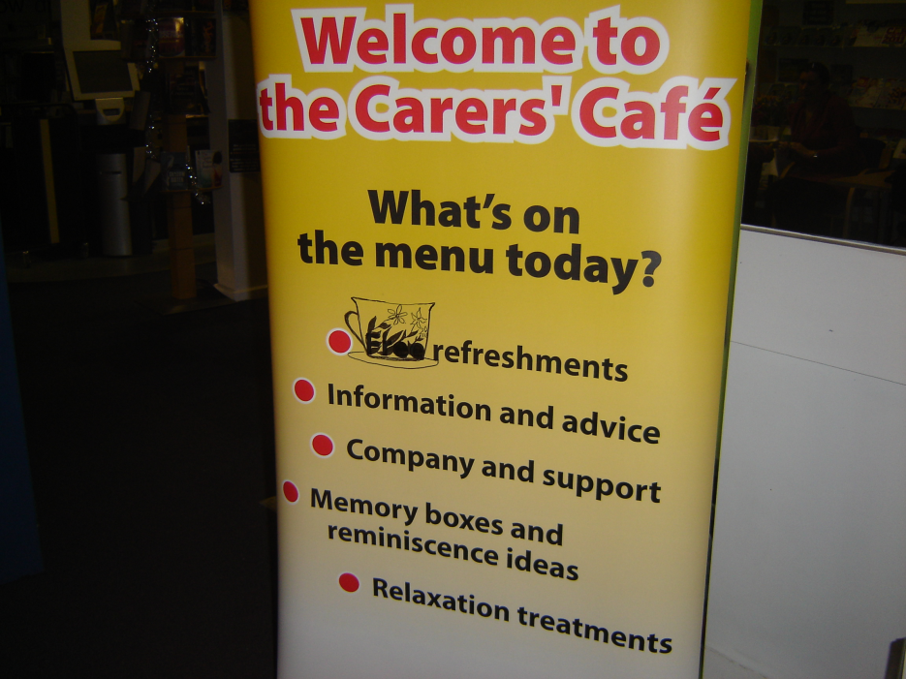
Responses 2: From Grant Aid to Spot Purchase
Previously grants from local councils to
  Carers Centre
  Carers local partnerships
  Direct access eg outreach & ‘carers cafés’
  One closed since last year although may be taken over
  Legacies of Carers Grant

Slide 12

Commissioners’ Responses (3) Outsourcing
Two examples of local carers’ organisations being asked to take on the role of co-ordinating carers forum/carers council from the council
Thinking around carers’ assessments (prior to Care and Support White Paper)
More expectations of welfare rights

Slide 13

The commissioner’s dilemma (1) Effectiveness?
I helped a lady who is a carer of her… son …and it’s very full on for her and she just needed a day to herself. So with our direct payments … she took herself off for a day’s pampering. That’s what she wanted to do so she had a massage, her hair cut and coloured, her fingers done, a pedicure. So that was quite nice for her and she’s ever so grateful and it’s boosted her batteries no end feeling good about herself (WORKER15)

Slide 14
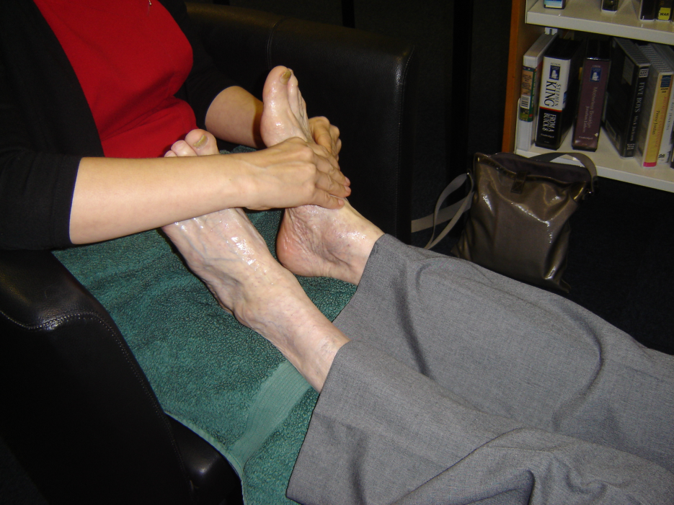
Or not?
I think these pamper days are a waste of time… You don’t get people that are trapped in their houses, the 91 year old looking after the 89 year old. They don’t come out for a pamper day. And your pampering lasts how long? And you remember it for how long? What difference does it make to your life in the grand scheme of things at the end of the day? It makes the people who put it on feel good, and it makes the funders feel great (WORKER18)

Slide 15
The Commissioner’s Challenge….
Model assumes people will recognise themselves as carers and be proactive
HUGE research literature showing this is not the case
  For example, Carers UK 2001 report ‘It could be you’
  And our further findings of hidden, hard to reach and stigmatised carers.

Slide 16

Thank you to….
Everyone who was interviewed or who returned a survey
Lizzy, Jenny, Mark, and Carolyn who helped with interviewing
Lizzy for help with data entry and coding
Virtual Outsourcing, Laptop Confidential and Voicescript who did the transcribing
The Project Advisory Group and the Unit Service User and Carer Advisory Group
To SSCR for funding
To you for listening!

Slide 17
Disclaimer
The preparation of this presentation was made possible by a grant from the National Institute for Health Research (NIHR) School for Social Care Research on social care practice with carers. The views expressed in this presentation are those of the authors and not necessarily those of the NIHR School for Social Care Research or the Department of Health/NIHR
Notes:
17

