Slide 1

Enterprise, Being your own boss, Becoming self employed, Starting up…..

Slide 2
Campus Enterprise Opportunities (CEO)
Helps students, staff and graduates of DMU to start their own business, become self employed or set up as a freelancer.

Slide 3
Based in the Careers & Employability team
Student Gateway
Gateway House
www.dmu.ac.uk/ceo
0116 2078914
ceo@dmu.ac.uk

Slide 4

Final year students or graduates within the last 3 years
9 month program
£2,500 bursary and £3,000 worth of business support
30 places available each year
Deadline for applications 12 April 2013
www.enterpriseinc.co.uk

Slide 5









Slide 6
Enterprise day
8.45 – 9.15am How to generate ideas
9.15 – 9.30am Launch challenge
9.30 – 12.30pm Work on challenge
                Meet facilitators / Mentors
12.30- 1.00pm Lunch
1.00 – 2.00pm Finalise details for pitch
2.00 – 3.00pm Pitches
3.00 – 4.00pm Awards

Slide 7
What makes a good idea?

Slide 8
Ideas
Where do ideas come from?
What are you good at
What do you enjoy doing
Can either become a business

Slide 9
What is innovation?
  NOT !
    Invention
      Invention is a creative idea but innovation makes it work
    Innovation = new products or services only
      Can also lead to new processes, markets and quality
    Innovation is always original
      New ideas always have roots in old ideas – points of pain
      Its the combination / adaptation of old ideas which is original

Slide 10

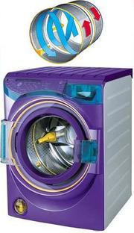
Innovation
2 main types
  Radical innovation
    Major changes culminating in either a entirely new product or servicing customers needs in a new way

Slide 11





  Incremental innovation
    Continual improvements on existing products or services

Slide 12
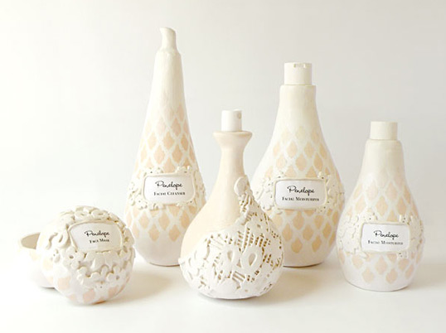
Other innovation
Unique 3D bottle design

Slide 13

Meat packaging

Slide 14

Juice bottle design

Slide 15

Spaghetti packaging

Slide 16

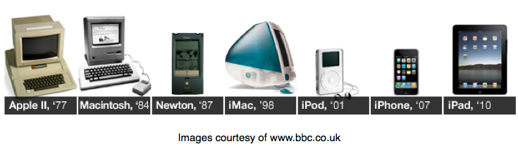
And finally…
One of the leaders in design innovation

Slide 17
When thinking about an idea look to the bigger picture
  Political
  Economic
  Social Cultural
  Technological
  Environmental
  Legal

Slide 18
That said ideas do not have to be:
  Imaginative
  Unique
  Different
  There is nothing wrong with delivering something that already exists
  The key is to have a USP and a CVP

Slide 19
Evaluate your idea
Will it work?
  Who are the potential customers of the idea?
  What is similar or unique about the idea compared with what’s already on the market?
  How and where will your customers purchase the product/service?
  What problem (point of pain) does the idea solve?
  Is something about it different
    Price
    Quality
    Service

Slide 20
So you think you are ready
Next Steps
  Market research
  Decide on type of business to form
  Business planning
  Financial planning
  Most of all contact Campus Enterprise Opportunities

Slide 21
The challenge should you wish to accept it………

Slide 22

Work in a team to come up with an idea for a product or service to help increase tourism in Leicester.
3 hours to work on idea
Help from mentor
Pitch your idea to the DMU Dragons
Prizes to be won!

Slide 23
What to do next
Get into teams of 5/6
Meet your mentor
Brainstorm potential ideas
Carry out market research about your idea
Refine idea
Decide how much you need from the Dragons
Practice your pitch

